Slide 1
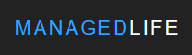

Life Management 1.0
Team Members: Beatriz Hernandez, Fernando Mojena
Product Owner: Ranjeet Deshmukh
Instructor: Masoud Sadjadi
Final Presentation
Summer 2017
Notes:
7 seconds.( I will select 2 best slides (i will give them extra points and students will present for CIS committee)
Greet your audience, thank them for attending your presentation, introduce yourself, introduce your project, introduce your team members, and quickly indicate what each of you did in a high-level manner, and put more emphasis on your part/contribution.

Slide 2
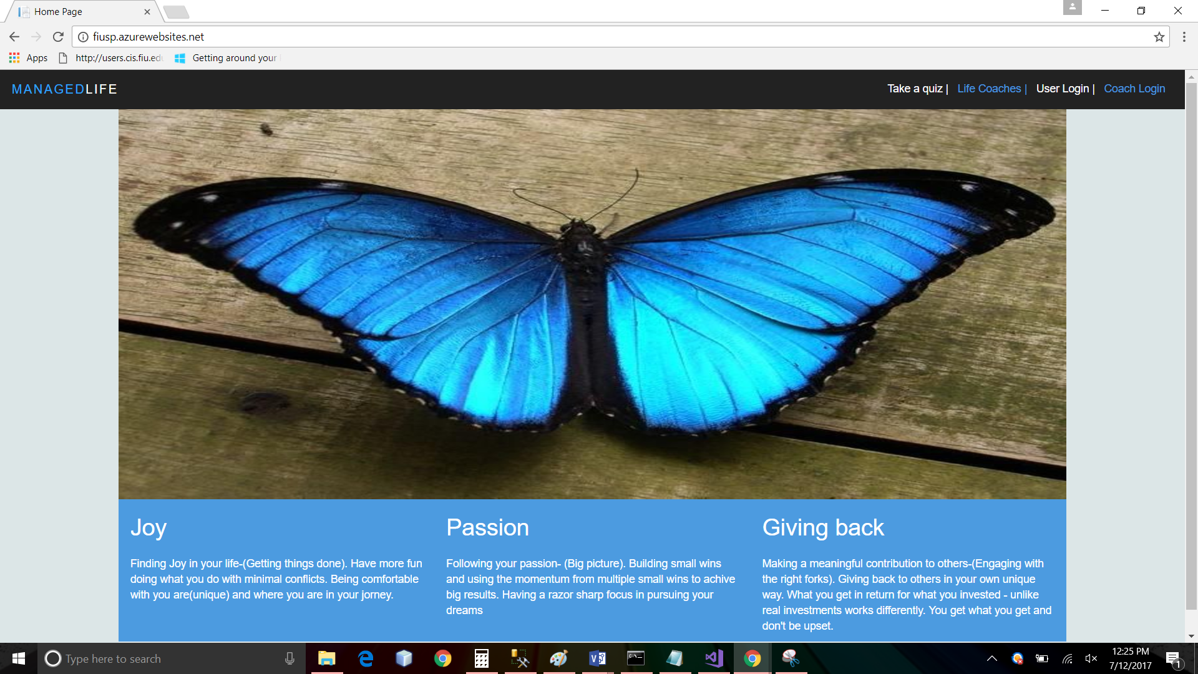
Project definition
Notes:
20 seconds.
Introduce the problem that the your project (in new version) tackles with GIF or screenshot.

Slide 3
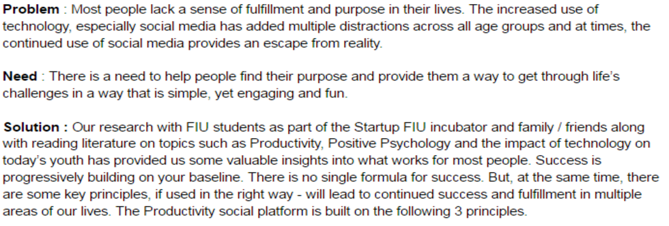
Project definition
Notes:
10 seconds.
Introduce the problem that the whole project (in all versions) tackles with GIF or screenshot.

Slide 4
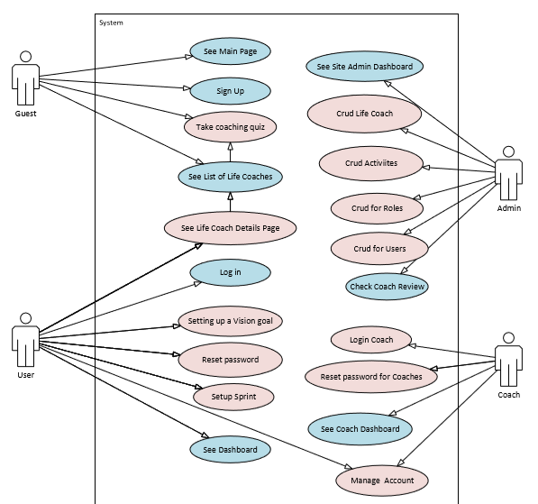
Requirements: Use Cases
Notes:
5 seconds
Show the Use Case Diagram for the whole project. Highlight your use cases.

Slide 5
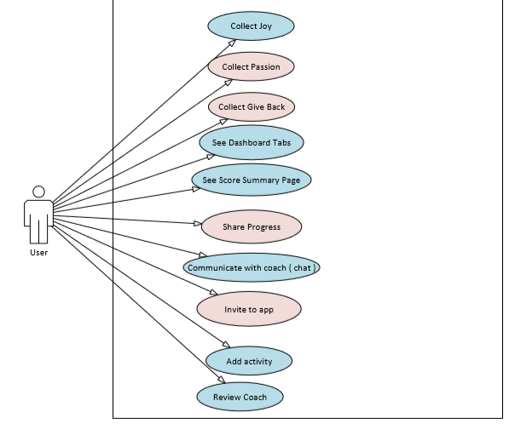
Requirements: Use Cases (Continue)
Notes:
5 seconds
Show the Use Case Diagram for the whole project. Highlight your use cases.

Slide 6
System Design: Architecture
System decomposition: The system was built using MVC architecture.
Deployment: Currently deployed to Azure
Minimum requirements:
IIS or Web app hosted in Azure (.Net Framework: 4.5.2)
SQL Server 2012 or later version
Visual Studio 2015
Notes:
20 seconds
System design: Highlight the parts that you contributed to them.
1. System decomposition; identify the architecture patterns used
2. System deployment – h/w and s/w requirements

Slide 7
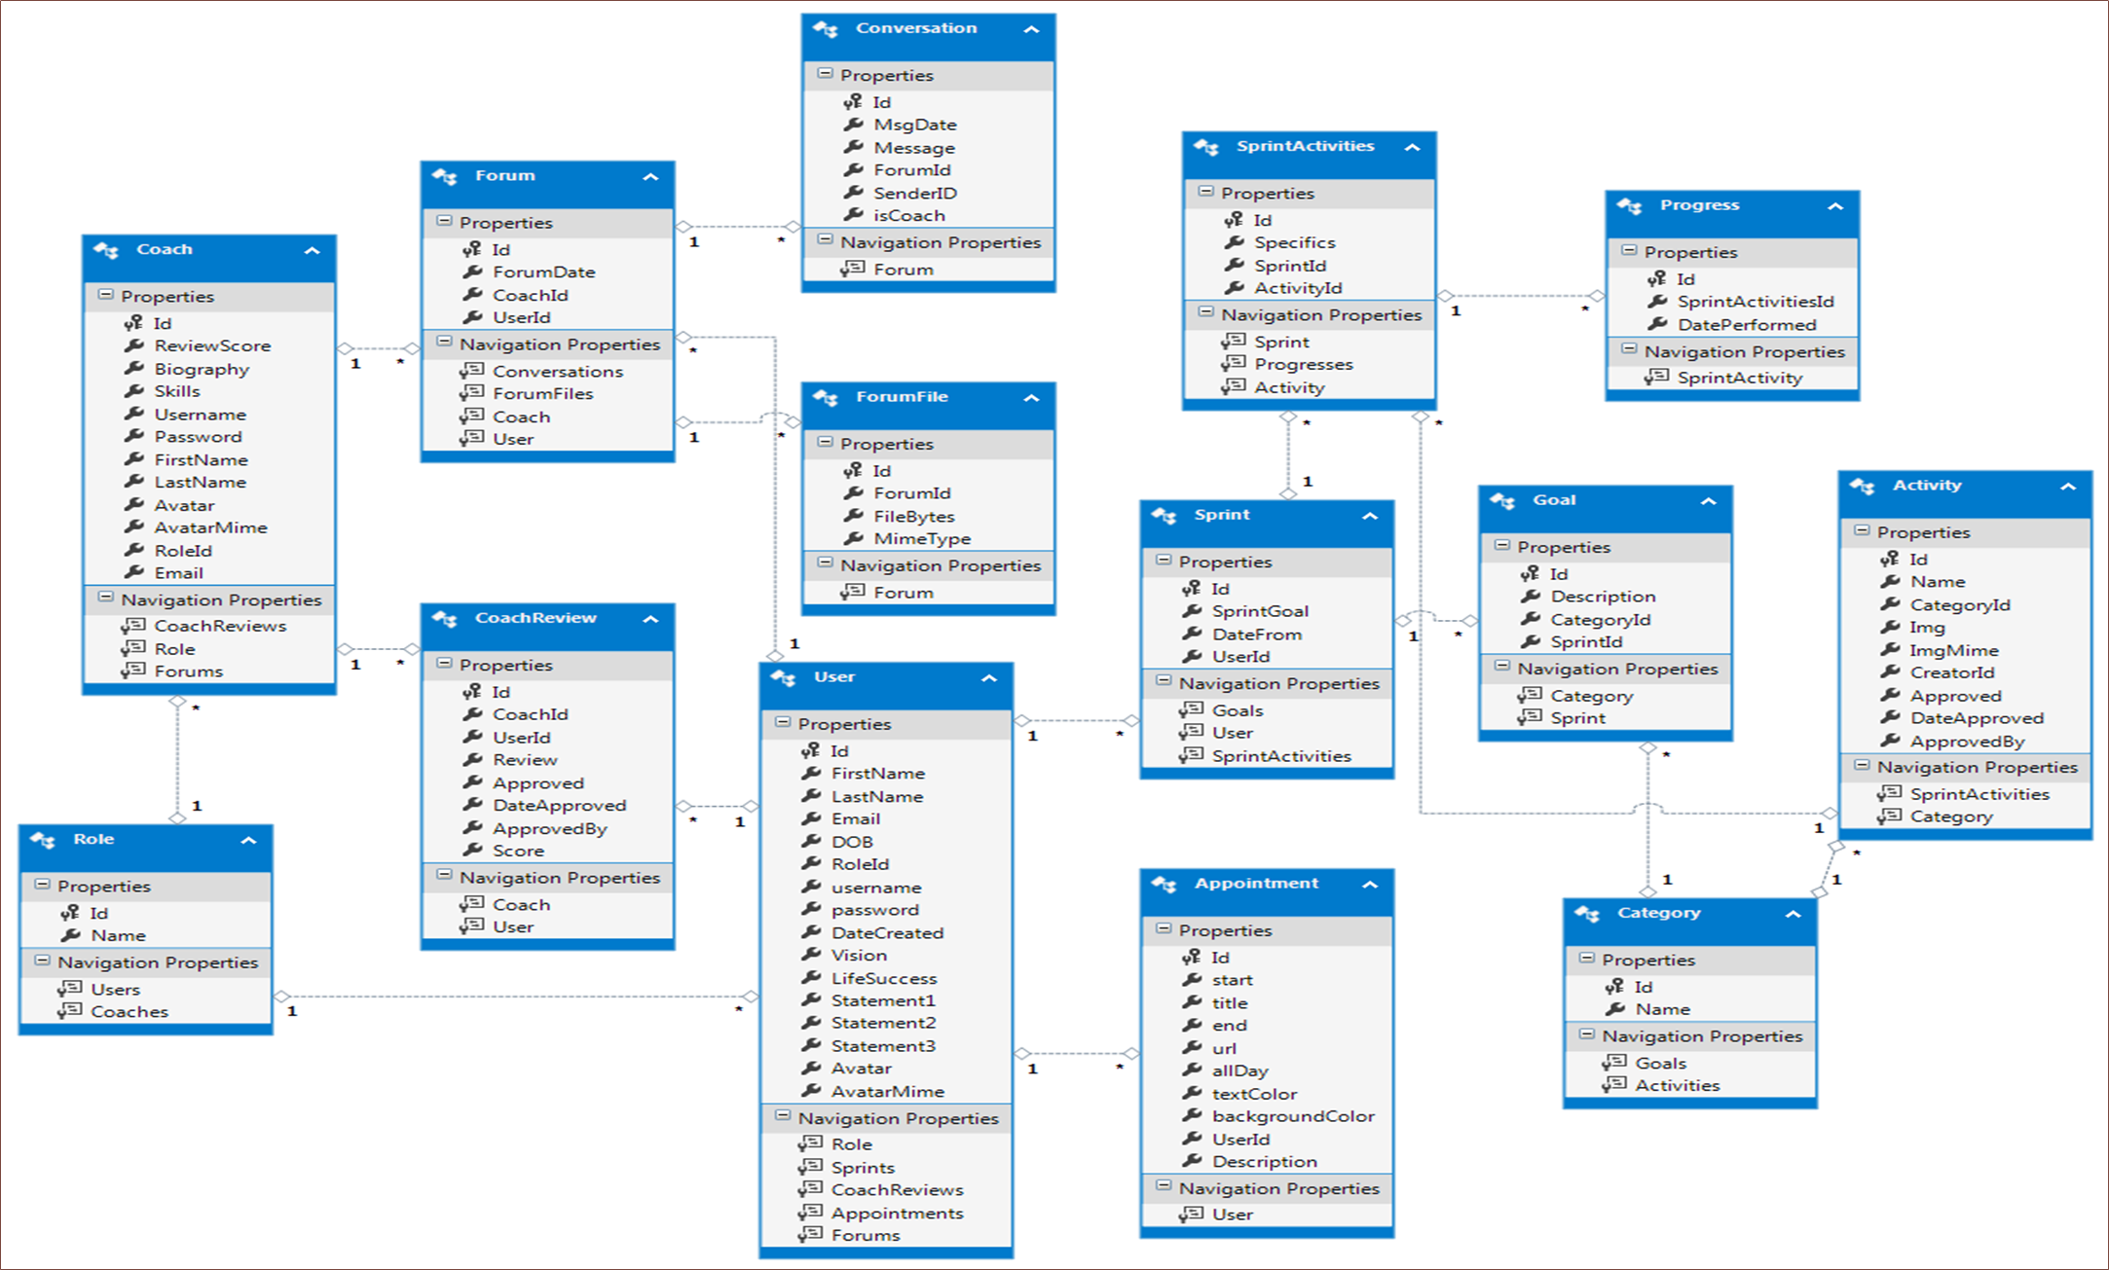
Minimal Class Diagram
Notes:
10 seconds.Minimal class diagram. Highlight the classes that you created/modified
Identify the design patterns used (one or more slides).

Slide 8
User Stories
Setup vision Goal
Collect Joy
Add a Life Coach
Share progress
Communicate with coach
Review Coach
Notes:
5 seconds.
List the user stories that you worked on them.(put in order of importance). Stay focused on the parts that you have been working.

Slide 9
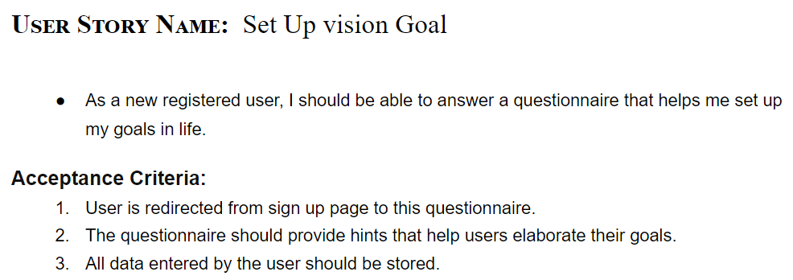
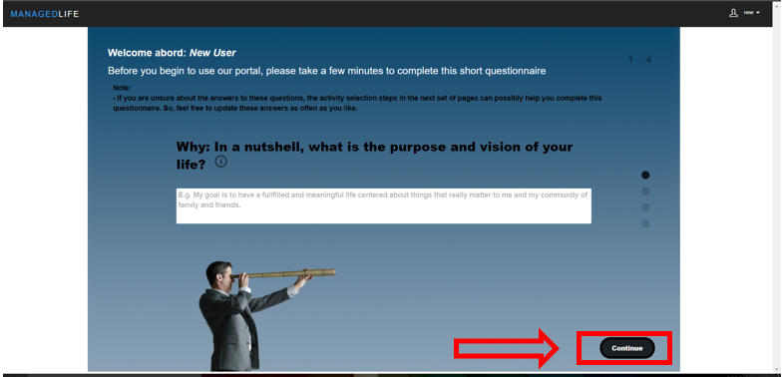
User Story #1
Notes:
60 seconds
The tile of user story
The most important user story you worked on it. You have to describe this one very well and be proud of that.
Please present and show the complexity of your work, code, algorithms, and technical challenges and technologies you have used. (you could use screenshot if you want. Visual presentations are better than text presentation)
Go into the details of the most important/significant tasks using bullet lists or visual graphs or state chart diagram
Sequence Diagram for this user story is mandatory (in another separate page if required)
Demo using screenshots or GIF (in another separate page if required)

Slide 10
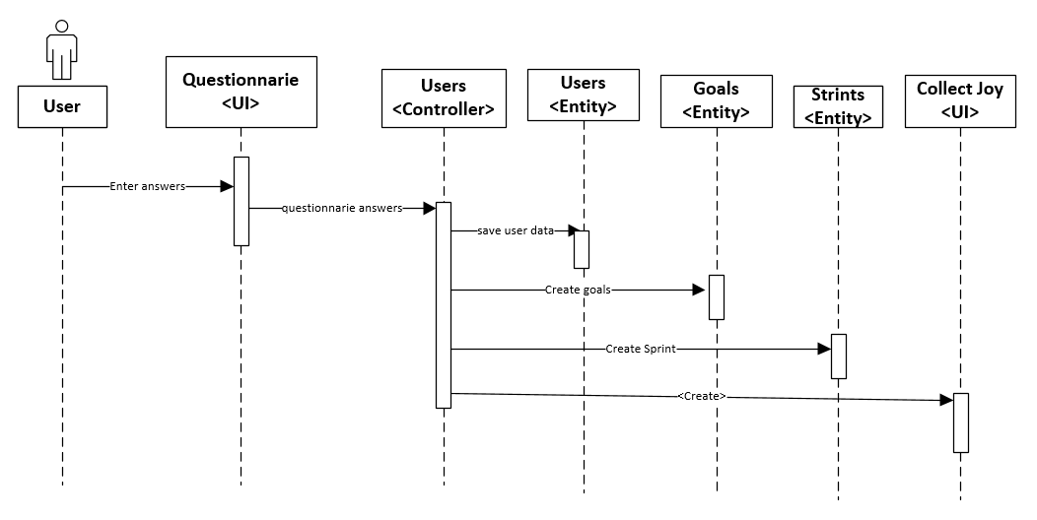
User Story #1 (Continue)
Notes:
60 seconds
The tile of user story
The most important user story you worked on it. You have to describe this one very well and be proud of that.
Please present and show the complexity of your work, code, algorithms, and technical challenges and technologies you have used. (you could use screenshot if you want. Visual presentations are better than text presentation)
Go into the details of the most important/significant tasks using bullet lists or visual graphs or state chart diagram
Sequence Diagram for this user story is mandatory (in another separate page if required)
Demo using screenshots or GIF (in another separate page if required)

Slide 11
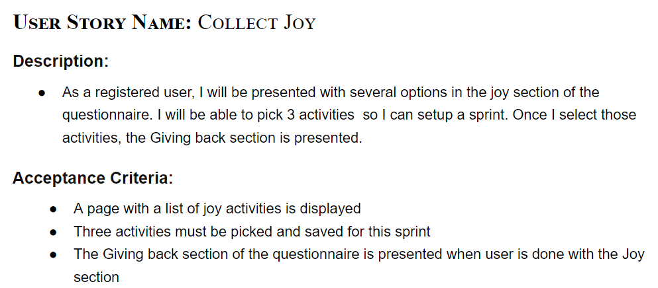
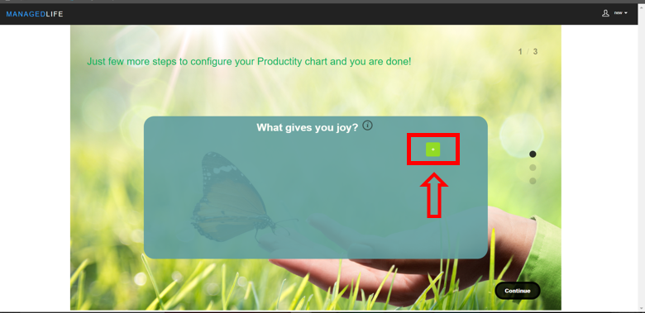
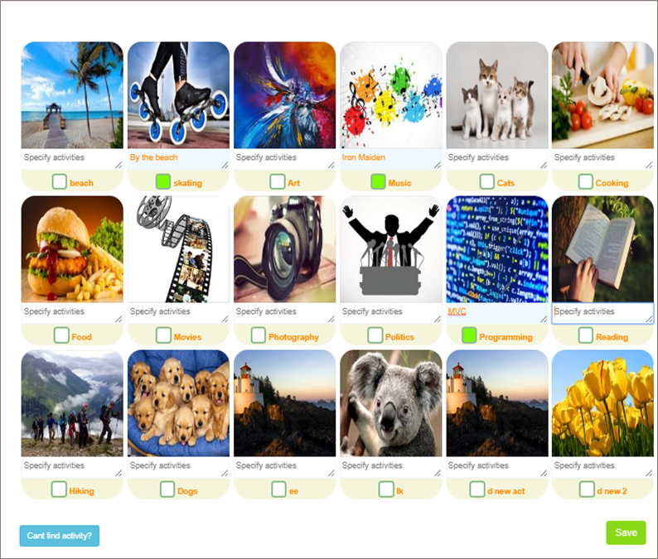
User Story #2
Notes:
60 seconds
The tile of user story
The most important user story you worked on it. You have to describe this one very well and be proud of that.
Please present and show the complexity of your work, code, algorithms, and technical challenges and technologies you have used. (you could use screenshot if you want. Visual presentations are better than text presentation)
Go into the details of the most important/significant tasks using bullet lists or visual graphs or state chart diagram
Sequence Diagram for this user story is mandatory (in another separate page if required)
Demo using screenshots or GIF (in another separate page if required)

Slide 12
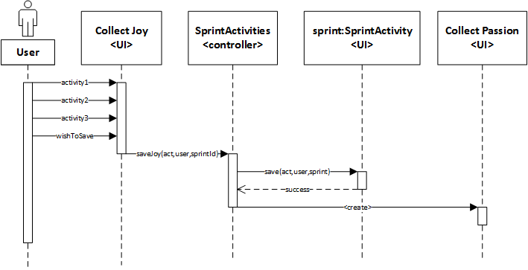
User Story #2 (Continue)
Notes:
60 seconds
The tile of user story
The most important user story you worked on it. You have to describe this one very well and be proud of that.
Please present and show the complexity of your work, code, algorithms, and technical challenges and technologies you have used. (you could use screenshot if you want. Visual presentations are better than text presentation)
Go into the details of the most important/significant tasks using bullet lists or visual graphs or state chart diagram
Sequence Diagram for this user story is mandatory (in another separate page if required)
Demo using screenshots or GIF (in another separate page if required)

Slide 13
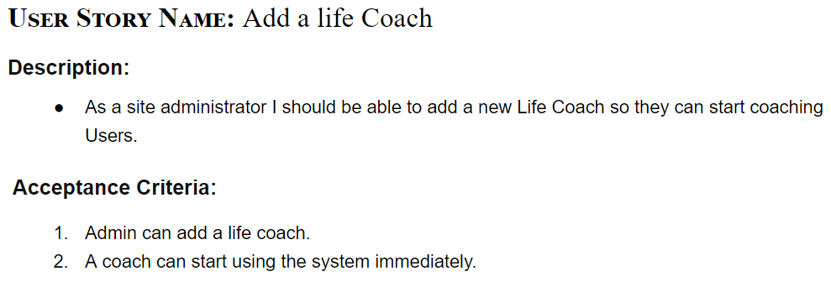
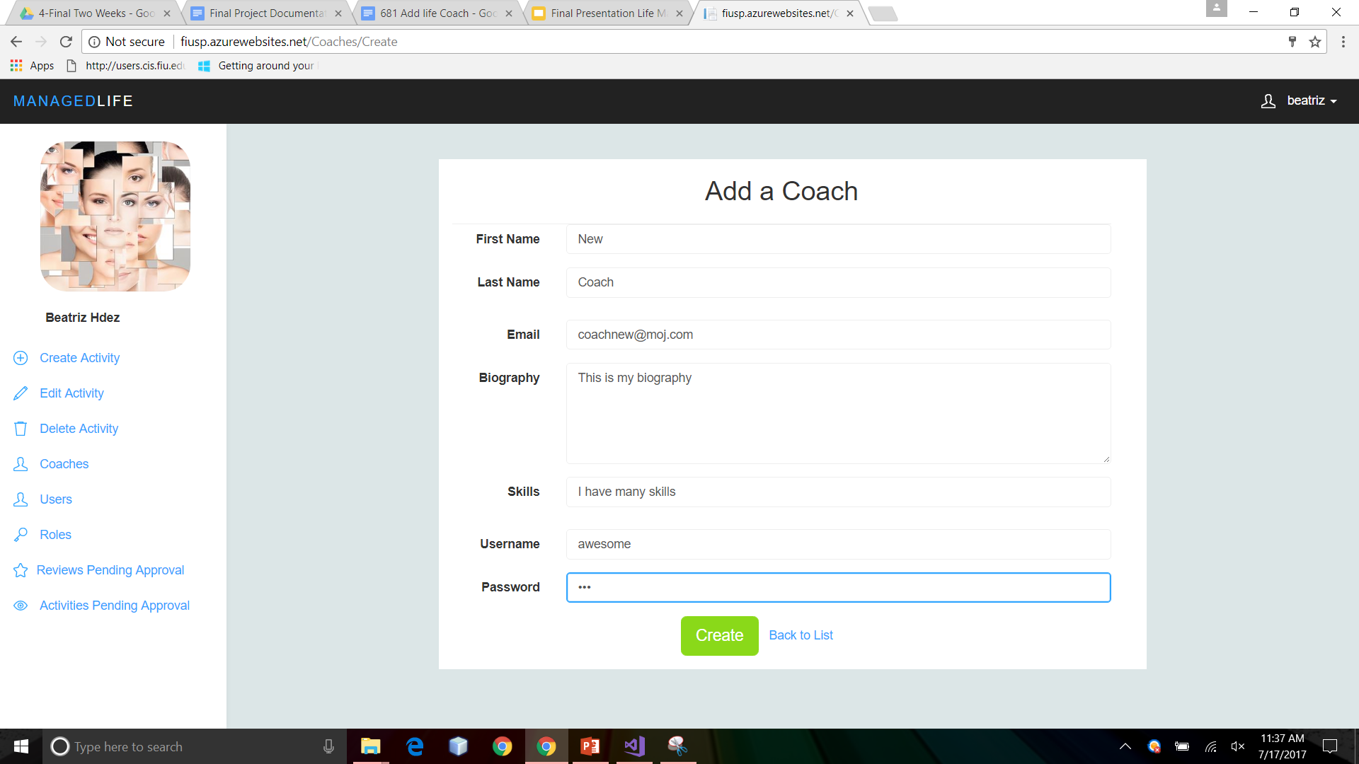
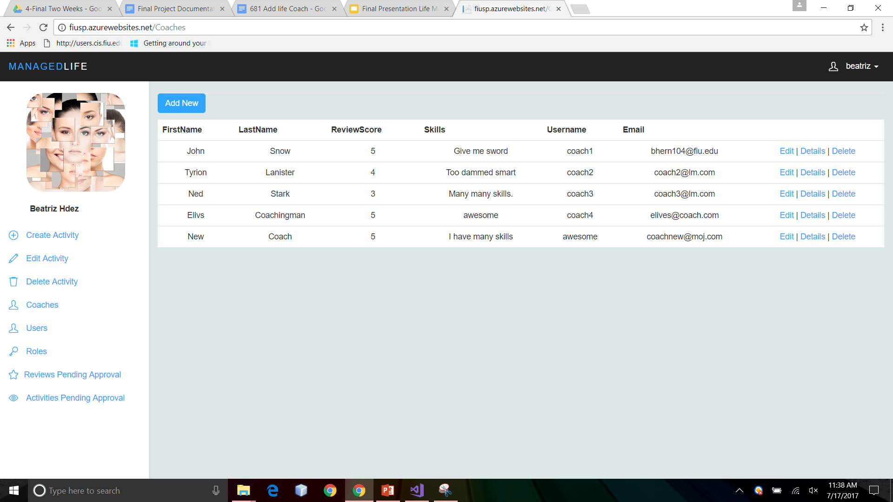
User Story #3
Notes:
60 seconds
The tile of user story
The most important user story you worked on it. You have to describe this one very well and be proud of that.
Please present and show the complexity of your work, code, algorithms, and technical challenges and technologies you have used. (you could use screenshot if you want. Visual presentations are better than text presentation)
Go into the details of the most important/significant tasks using bullet lists or visual graphs or state chart diagram
Sequence Diagram for this user story is mandatory (in another separate page if required)
Demo using screenshots or GIF (in another separate page if required)

Slide 14
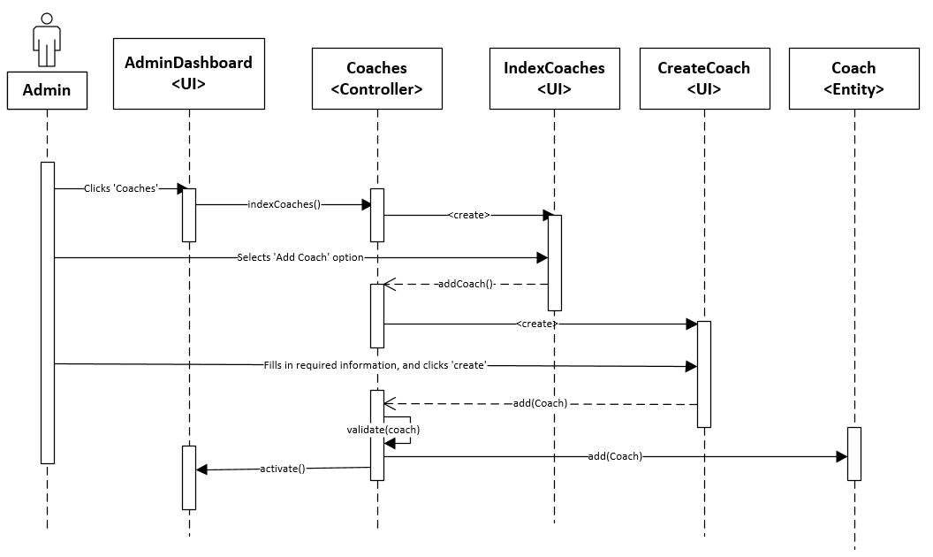
User Story #3 (Continue)
Notes:
60 seconds
The tile of user story
The most important user story you worked on it. You have to describe this one very well and be proud of that.
Please present and show the complexity of your work, code, algorithms, and technical challenges and technologies you have used. (you could use screenshot if you want. Visual presentations are better than text presentation)
Go into the details of the most important/significant tasks using bullet lists or visual graphs or state chart diagram
Sequence Diagram for this user story is mandatory (in another separate page if required)
Demo using screenshots or GIF (in another separate page if required)

Slide 15
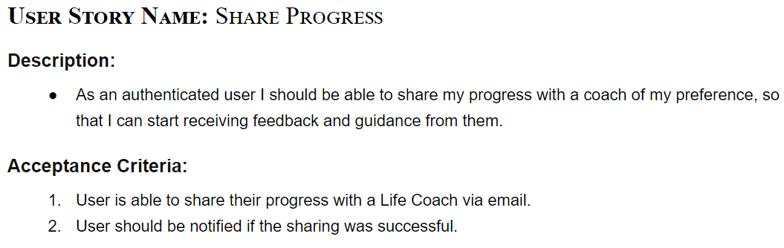
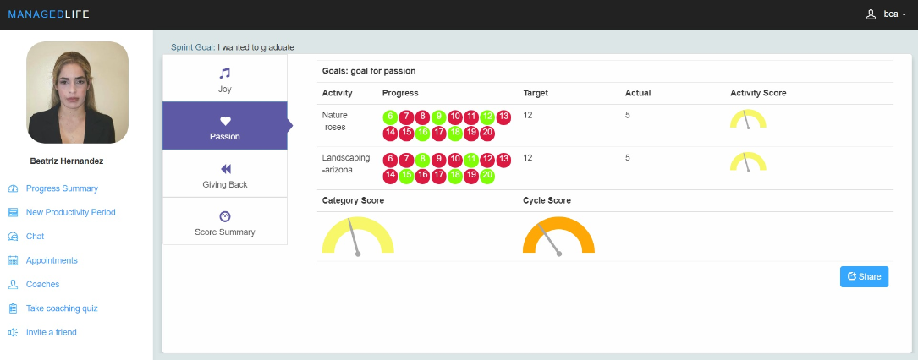
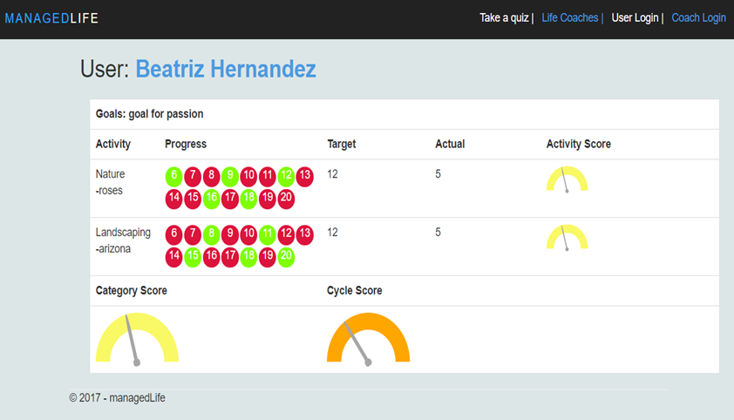
User Story #4
Notes:
60 seconds
The tile of user story
The most important user story you worked on it. You have to describe this one very well and be proud of that.
Please present and show the complexity of your work, code, algorithms, and technical challenges and technologies you have used. (you could use screenshot if you want. Visual presentations are better than text presentation)
Go into the details of the most important/significant tasks using bullet lists or visual graphs or state chart diagram
Sequence Diagram for this user story is mandatory (in another separate page if required)
Demo using screenshots or GIF (in another separate page if required)

Slide 16
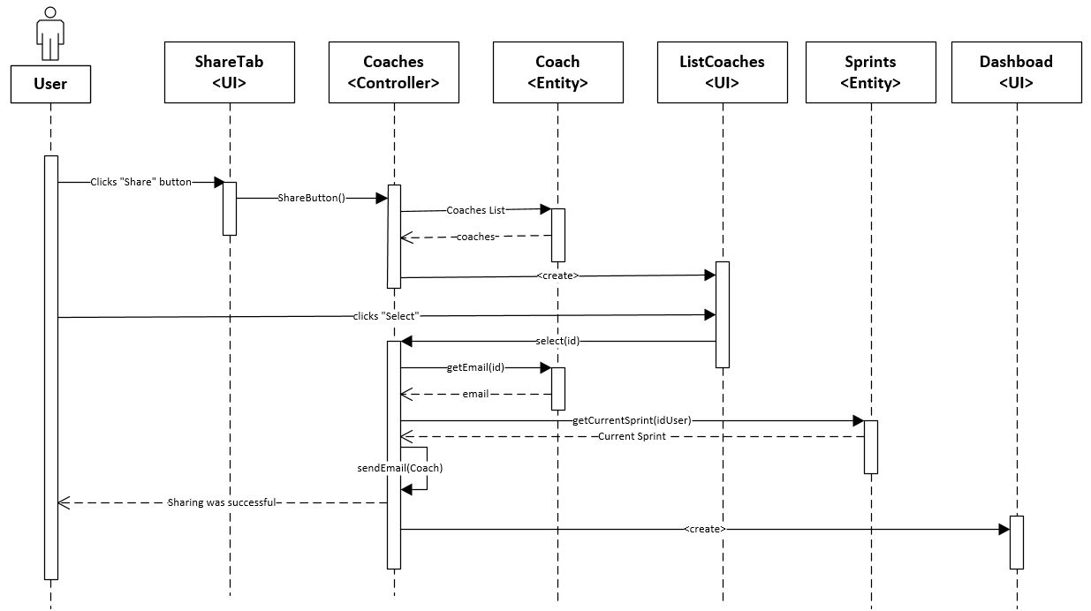
User Story #4(Continue)
Notes:
60 seconds
The tile of user story
The most important user story you worked on it. You have to describe this one very well and be proud of that.
Please present and show the complexity of your work, code, algorithms, and technical challenges and technologies you have used. (you could use screenshot if you want. Visual presentations are better than text presentation)
Go into the details of the most important/significant tasks using bullet lists or visual graphs or state chart diagram
Sequence Diagram for this user story is mandatory (in another separate page if required)
Demo using screenshots or GIF (in another separate page if required)

Slide 17
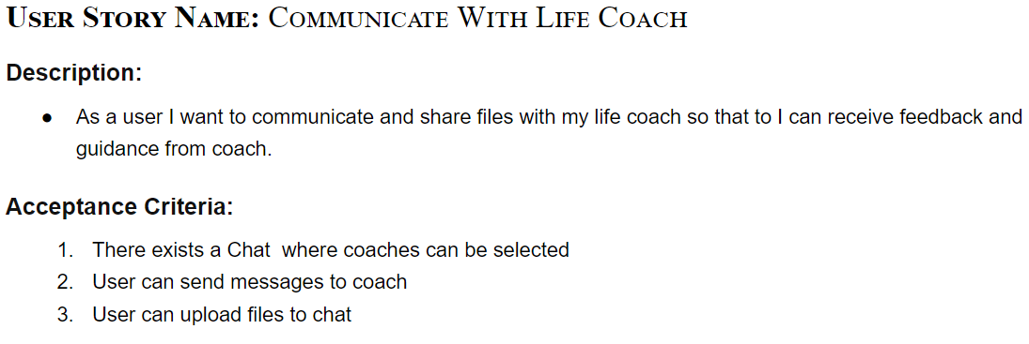
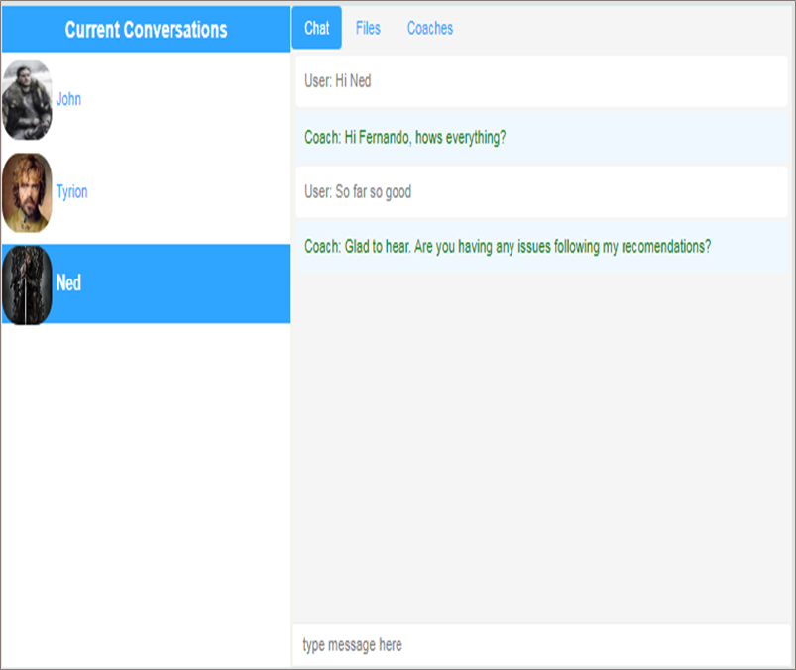
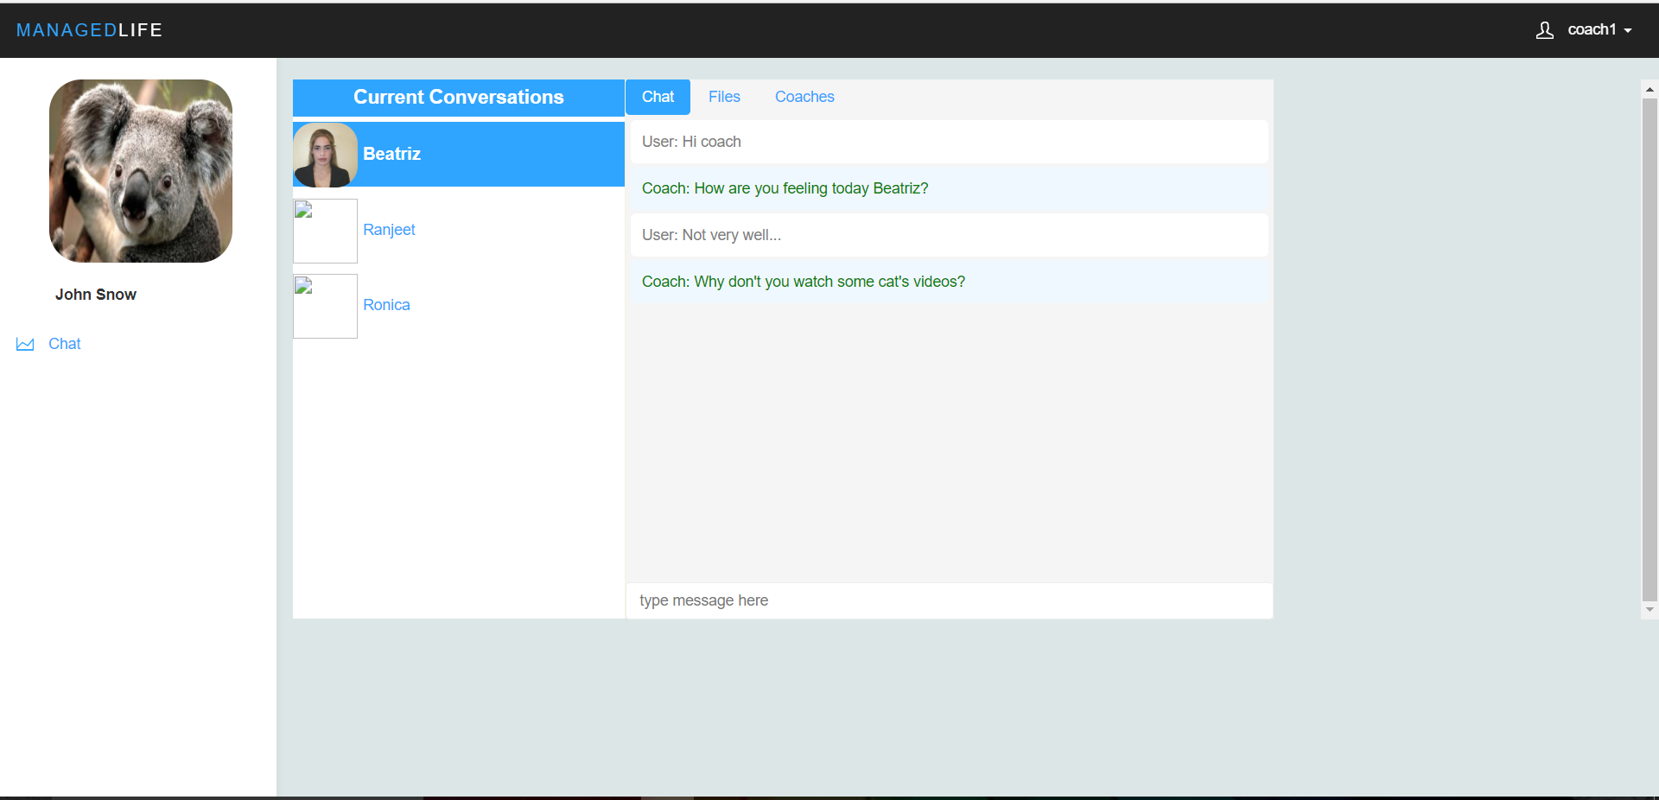
User Story #5
Notes:
60 seconds
The tile of user story
The most important user story you worked on it. You have to describe this one very well and be proud of that.
Please present and show the complexity of your work, code, algorithms, and technical challenges and technologies you have used. (you could use screenshot if you want. Visual presentations are better than text presentation)
Go into the details of the most important/significant tasks using bullet lists or visual graphs or state chart diagram
Sequence Diagram for this user story is mandatory (in another separate page if required)
Demo using screenshots or GIF (in another separate page if required)

Slide 18
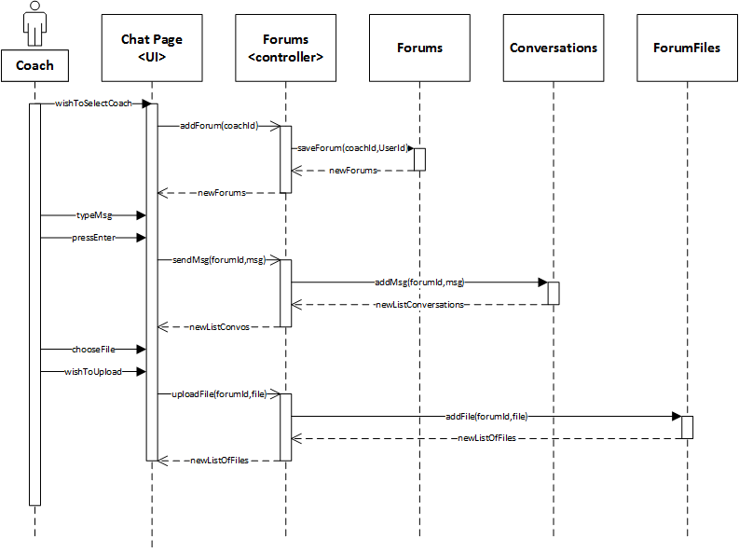
User Story #5(Continue)
Notes:
60 seconds
The tile of user story
The most important user story you worked on it. You have to describe this one very well and be proud of that.
Please present and show the complexity of your work, code, algorithms, and technical challenges and technologies you have used. (you could use screenshot if you want. Visual presentations are better than text presentation)
Go into the details of the most important/significant tasks using bullet lists or visual graphs or state chart diagram
Sequence Diagram for this user story is mandatory (in another separate page if required)
Demo using screenshots or GIF (in another separate page if required)

Slide 19
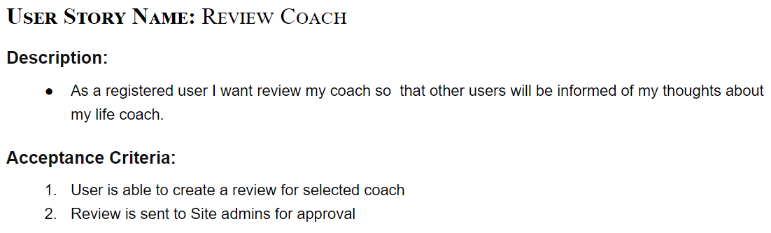
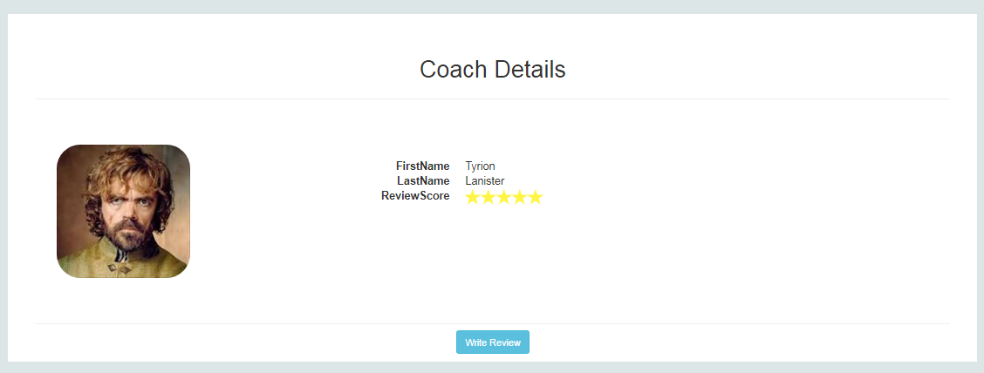
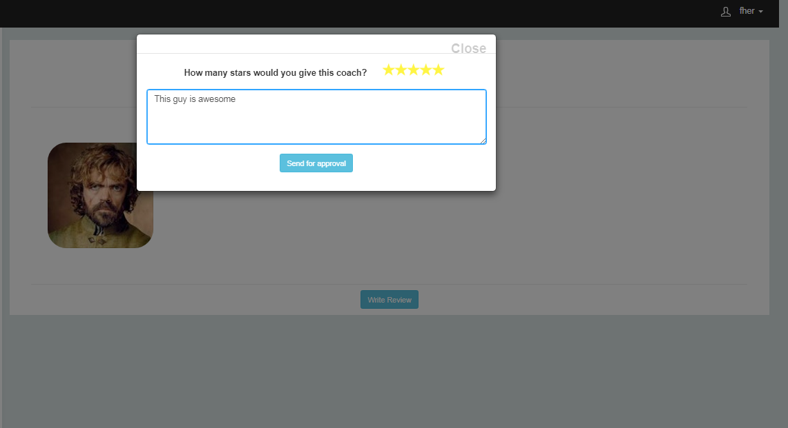
User Story #6
Notes:
60 seconds
The tile of user story
The most important user story you worked on it. You have to describe this one very well and be proud of that.
Please present and show the complexity of your work, code, algorithms, and technical challenges and technologies you have used. (you could use screenshot if you want. Visual presentations are better than text presentation)
Go into the details of the most important/significant tasks using bullet lists or visual graphs or state chart diagram
Sequence Diagram for this user story is mandatory (in another separate page if required)
Demo using screenshots or GIF (in another separate page if required)

Slide 20
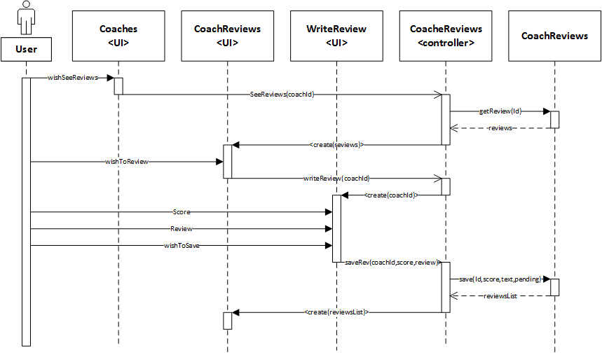
User Story #6(Continue)
Notes:
60 seconds
The tile of user story
The most important user story you worked on it. You have to describe this one very well and be proud of that.
Please present and show the complexity of your work, code, algorithms, and technical challenges and technologies you have used. (you could use screenshot if you want. Visual presentations are better than text presentation)
Go into the details of the most important/significant tasks using bullet lists or visual graphs or state chart diagram
Sequence Diagram for this user story is mandatory (in another separate page if required)
Demo using screenshots or GIF (in another separate page if required)

Slide 21
Test Suites and Test Cases
Unit testing was performed for each user story after completion.
The tests consisted in both white and black boxes.
Integration tests were also performed throughout all the development cycle.
Usability tests, were carried out as well, by having friends and professionals to use the system, in order to detect possible downfalls.
The owner, had also validated the product during each of our bi-weekly meeting, where we either demo our progress, or have himself to use the site.
Notes:
10 seconds
A description of verification process and Test Suites and Test Cases for one of the use cases.
1 One sunny day and one rainy day for the implemented use cases (one or more slides).
2 Automated test scripts for the implemented use cases (if any) (one or more slides).

Slide 22






Summary
To sum up, this solution will help users identity their life’s priorities, align them with their vision and help them visualize their growth. Giving them a sense of fulfillment and self-confidence, needed to reach their goals and true potential.
Beatriz Hernandez , beatrizhs89@gmail.com
Fernando Mojena Amaya, fmojena@gmail.com
> Questions?
>Thank You!
Notes:
10 seconds
Summarize your contribution, mention your effort for Scrum, Mingle, Github, Google Drive Documentation and minutes
Include your contact information
Ask if anyone has any questions for you.
Thank your audience

